Slide 1
Referencing for Postgraduate Students
Dr Rachael Major

Slide 2
Objectives
To review sources of evidence
To describe how to cite sources of evidence
To discuss how to use library citation tools available
To practice referencing

Slide 3
Why is referencing important?
It shows that you have read a range of literature and that what you are saying is based on that literature than just your own ideas.
It gives an indication of the quality of the literature you are using as a basis for your understanding
If you are using other people’s ideas it is academic good practice to acknowledge the original author
If you copy exact words from someone else’s work and do not say you are doing so you are committing Plagiarism which is a serious academic offence
Referencing will contribute to your mark

Slide 4
Sources of Evidence
Text books
Journal articles
Professional websites
Government sites/documents
Avoid patient websites

Slide 5
Access Guidance –
On Learning Pod Masters Home page https://theinstitute.gov.gg/course/view.php?id=987
On Institute Library page: https://theinstitute.gg/library

Slide 6
The 2 components of Referencing
There are two aspects of referencing to consider:
When you refer to sources within your main body of writing
Providing a full reference list
Every source referred to in your writing must be in your reference list.
Every author referred to in your reference list should be in your main writing.
Check this because the marker will!

Slide 7
There are two ways to cite references in your work:
1. Within your sentence:
Jones and Smith (2024) discovered that …………….
This was identified as a much better option by Jones and Smith (2024).
2. To support your sentence:
This care package was demonstrated to provide a more person-centred approach (Jones and Smith, 2024).
Research has suggested that this is the optimum time to intervene (West and East, 2023; Jones and Smith, 2024).

Slide 8
Within your sentence:
Jones and Smith (2024) discovered that …………….
This was identified as a much better option by Jones and Smith (2018).
The rules:
Only use surnames and year of publication
No commas needed
If the sentence would not make sense without the names being included in the sentence then only the date goes in brackets but not the names, i.e.:
“Jones and Smith (2024) discovered that chocolate tastes good” works
“Discovered that chocolate tastes good” would not make sense.

Slide 9
2. To support your sentence:
Care packages such as these have been demonstrated to provide a more person-centred approach (Jones and Smith, 2024).
The rules:
Only use surnames and year of publication
If the sentence would make sense without the names being included in the sentence then the name goes in the brackets with the date
Comma before the date
All within the sentence before the full stop.

Slide 10
How many authors do you cite in the text?:
1. One Author:
Brown (2018) believed that …………….
2. Two or three Authors (all are included):
Williams and Blandford-Smythe (2016) believed that …
3. Three or more Authors:
Hiram et al. (2019) believed that …………...

Slide 11
Some other things to consider:
1. If you are referring to the words of an author which is cited in another piece of literature (known as secondary reference) then:
Adamapule (2000) cited in King (2015) believed that ….
But try to avoid this - use the source you have read
2. If you want to abbreviate a name you must put it in full the first time:
The Nursing and Midwifery Council (NMC, 2018) Code states that ……..

Slide 12
Some other things to consider cont:
3. If an Author has written two pieces of work in the same year and you are using both assign an a or b:
West (2024a) suggested that ….. but in a later study (West 2024b) discovered ……..
4. If you are citing two pieces of literature at the same time:
It is commonly believed that … (East, 2018; North, 2020) or
East (2018) and North (2020) both agree that ……...
In chronological order with earliest date first

Slide 13
Direct Quotations:
If you insist on using them! It is better to use your own words.
To avoid being accused of Plagiarism!:
Ensure that you make it clear when you are providing direct quotations:
Put any quotations in “italics and quotation marks”
Provide the page number where you found the quotation as well as the author’s name and date
Copying diagrams without citing the author is also considered plagiarism
E.g “You must treat service users and carers as individuals” (Health and Care Professions Council (HCPC), 2016, p.5)

Slide 14
Reference List Tips:
1. Start writing your list as soon as you access some literature
2. Present your reference list in alphabetical order (Try to avoid starting with ‘The’ as it confuses the order)
3. Write names that can be shortened in full e.g. General Medical Council (not GMC)
4. Single space your list and leave an empty row between each reference
5. Details of publishers etc will be at front of book

Slide 15
Adding a Book to a Reference List
Authors, Initials. (Year). Title of book. (Edition). (only include this if not the first edition) Place: Publisher.
One Author:
Elllis, P. (2019). Evidence-based practice in nursing. (4th Ed) London: Learning Matters.
More than One Authors:
LoBiondo-Wood, G., Haber, J. and Titler, M. (2019). Evidence-based practice for nursing and healthcare improvement. St Louis: Elsevier.
Author’s initial as well as surname, but not first names in full.
All authors listed
Title of the book is in italics

Slide 16
Chapter of an edited book
Author of the chapter/section (surname followed by initials)
Year of publication (in round brackets)
Title of chapter/section (in single quotation marks)
'in' plus author/editor of book
Title of book (in italics)
Edition if not 1st edition (in brackets)
Place of publication: Publisher
Page reference
Karim, R., Tretten, T. and Kumar, U. (2018) ‘eMaintenance’, in M. Pecht and M. Kang (eds) Prognostics and health management of electronics: fundamentals, machine learning, and the internet of things. Hoboken, NJ: John Wiley & Sons, pp. 559–587.

Slide 17
Journal articles
Author (surname followed by initials)
Year of publication (in round brackets)
Title of article (in single quotation marks)
Title of journal (in italics – capitalise first letter of each word in title, except for linking words such as and, of, the, for)
Issue information: volume (unbracketed) and, where applicable, part number, month or season (all in round brackets)
Page reference (if available) or article number
If accessed online:
Available at: DOI or URL (if required) (Accessed: date)
Norrie, C., Hammond, J., D'Avray, L., Collington, V. and Fook, J. (2012) 'Doing it differently? A review of literature on teaching reflective practice across health and social care professions', Reflective Practice, 13(4), pp. 565–578.

Slide 18
Electronic journal article
Barke, M., Mowl, G. and Shields, G. (2010) ‘Málaga – a failed resort of the early twentieth century?’, Journal of Tourism History, 2(3), pp. 187–212. Available at: https://doi.org/10.1080/1755182X.2010.523145
Dutta, M. and Marjit, S. (2016) ‘Intra-country technology transfer’, Indian Economic Review, 51(1/2), pp. 117–127. Available at: http://www.jstor.org/stable/44376239 (Accessed: 27 May 2021).
Article number instead of page number
Iacobellis, G. (2020) ‘COVID-19 and diabetes: can DPP4 inhibition play a role?’, Diabetes Research and Clinical Practice, 162, article number 108125. Available at: https://doi.org/10.1016/j.diabres.2020.108125

Slide 19
Websites
Author
Year that the site was published/last updated (in round brackets)
Title of web page (in italics)
Available at: URL (Accessed: date)
Verlet, J.R.R. (2021) Dynamics of anion formation. Available at: http://www.verlet.net/edc.html (Accessed: 14 May 2021).

Slide 20
Website
Organisation
Year that the site was published/last updated (in round brackets)
Title of web page (in italics)
Available at: URL (Accessed: date)
National Health Service (2021) Coronavirus (COVID-19). Available at: https://www.nhs.uk/conditions/coronavirus-covid-19/ (Accessed: 17 May 2021).
Flixel (no date) Magical tools for visual storytelling. Available at: https://flixel.com/company/ (Accessed: 1 June 2021).

Slide 21
Government Guidance
Citation order:
Author
Year of publication (in round brackets)
Title (in italics)
Series or publication number (if given)
Place of publication: Publisher
If accessed online:
Available at: DOI or URL (Accessed: date)
National Institute for Health and Care Excellence [NICE] (2021) Postnatal care. NG194. Available at: https://www.nice.org.uk/guidance/ng194 (Accessed: 18 May 2021).

Slide 22
Legislation
In-text citation
The legislation (Fire Safety Act 2021) was too late to prevent the Grenfell disaster.
Title of Act including year and chapter number (in italics)
Country/jurisdiction (only if referencing more than one country's legislation)
Available at: URL (Accessed: date)
Reference list
Fire Safety Act 2021, c. 24. Available at: https://www.legislation.gov.uk/ukpga/2021/24/contents/enacted (Accessed: 17 May 2021

Slide 23
Personal correspondence
Sender/speaker/author
Year of communication (in round brackets)
Medium of communication
Receiver of communication
Day/month of communication
Walters, F. (2021) Facebook/Snapchat/WhatsApp/Signal/Threema/WeChat/ Telegram/Wire message to John Stephens, 6 June.
Walters, F. (2021) Conversation with John Stephens, 13 August.
Walters, F. (2021) Letter to John Stephens, 23 January.
Walters, F. (2021) Email to John Stephens, 14 August.
Walters, F. (2021) Telephone conversation with John Stephens, 25 January.

Slide 24
Local sources
To comply with the confidentiality policy for the purposes of academic writing please see below guidance to reference any local source within text and in reference list.
The required elements for a reference are:
Local Source - Authorship/Organisation. (Year). Full title of report. Place: Publisher.
Eg: Local Source - Committee for Health and Social Care. (2017). A Partnership of Purpose: Transforming Health and Care. Guernsey: States of Guernsey.
In-text Citation: In the main body of your assignment anything that relates to the Bailiwick of Guernsey (personal correspondence or place/department/organisation) must be referred to as follows:
A Partnership of Purpose (Local Source, 2017) states that…
Local Source (2017) highlighted that…

Slide 25
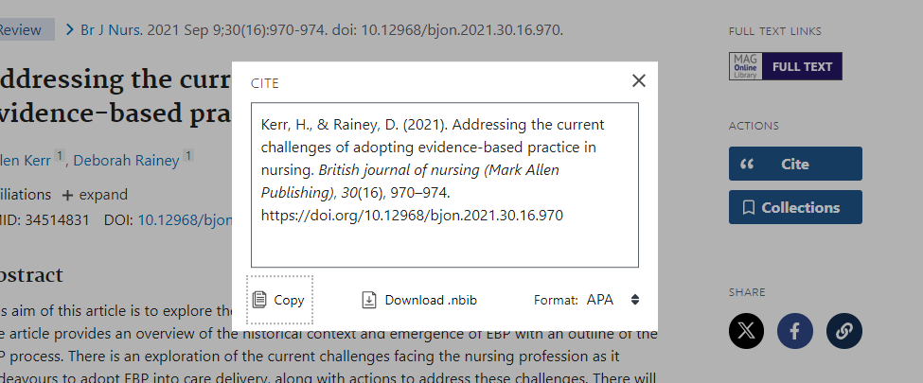
Tips
Pubmed and other sites will help you, although not exactly – use APA and amend

Slide 26
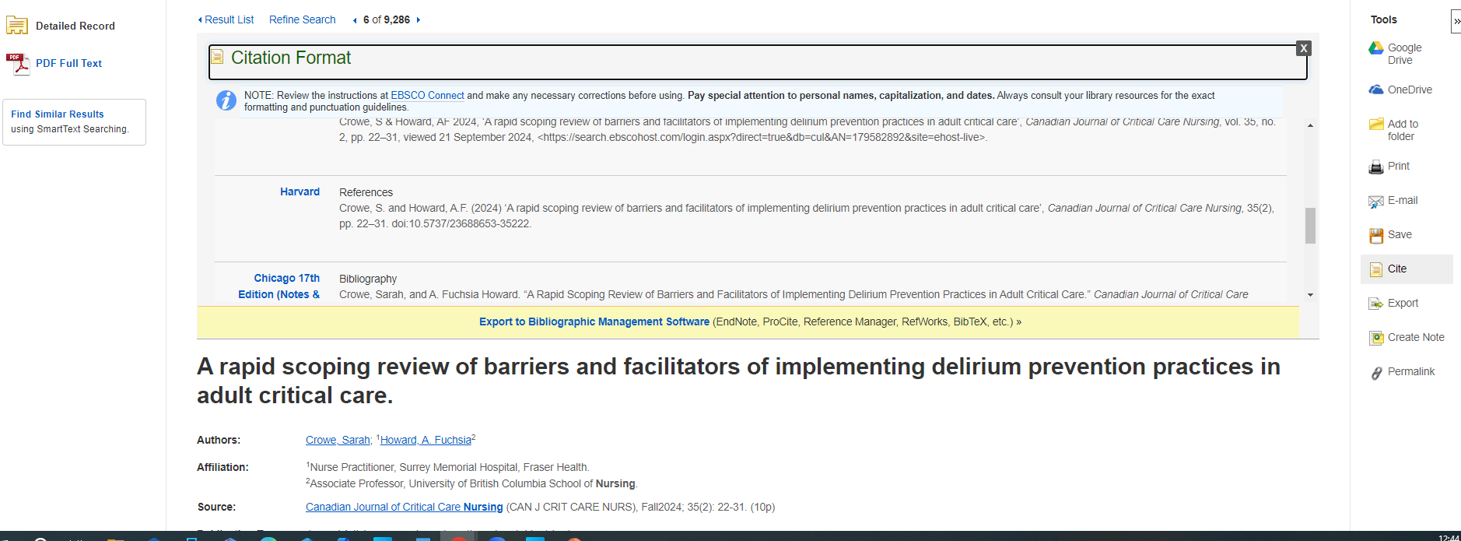
EBSCO Guernsey Library

Slide 27
Use of electronic software
Free sources such as :
Mendeley
Zotera
How to videos on: https://theinstitute.gov.gg/course/view.php?id=987

Slide 28
Now over to you:
Reference this guideline in text and in the reference list https://www.nice.org.uk/guidance/ng12
Reference an edited book chapter
Reference a journal https://doi.org/10.1111/jan.16058.
Notes:
Moloney, W., Cheung, G. and Jacobs, S. (2024) ‘Key elements to support primary healthcare nurses to thrive at work: A mixed‐methods sequential explanatory study’, Journal of Advanced Nursing (John Wiley & Sons, Inc.), 80(9), pp. 3812–3824. doi:10.1111/jan.16058.

